Slide 1
Star-ccm+ training marine simulation cases
Enrico di Capua

Slide 2
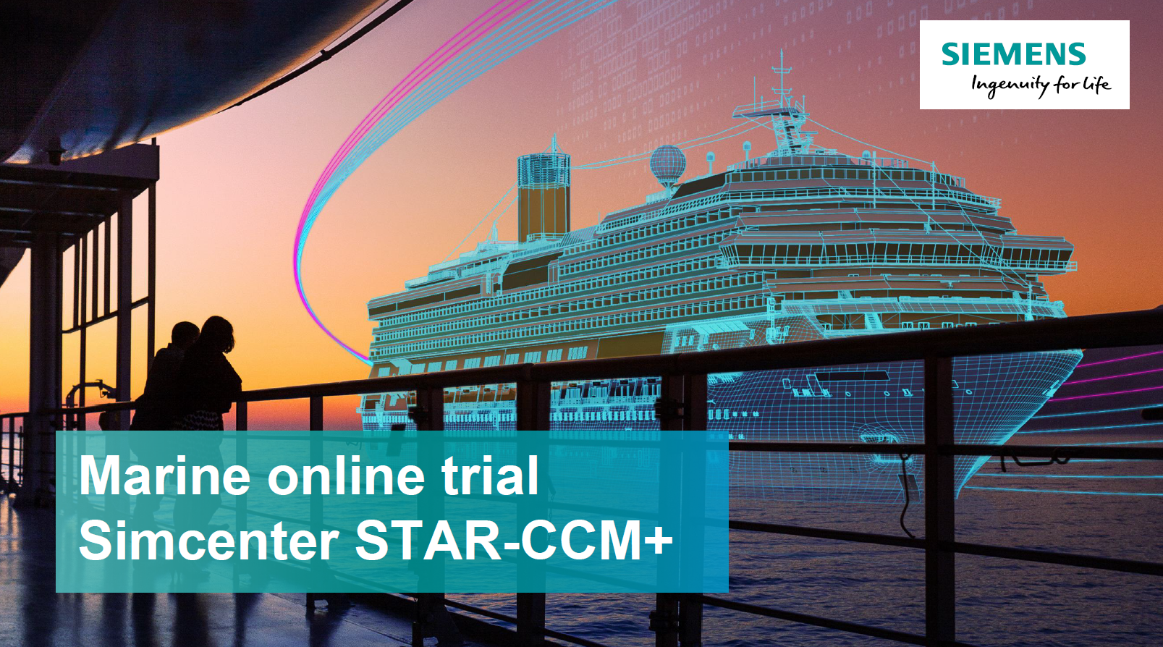

Slide 3
overview
Objective: CFD training using Siemens STAR-CCM+
AGENDA
STAR-CCM+
Case 1 – Hydrodynamic Performance
Case 2 – External Aerodynamics
Case 3 – Hydrofoil Design Exploration
Case 4 – Self-Propulsion
Conclusions

Slide 4
What is STAR-ccm+ ?
A multiphysics Computational Fluid Dynamics (CFD) software by Siemens
Provides simulation of fluid flow, heat transfer, and solid mechanics
Handles complex geometries and realistic operating conditions
Used by leading companies to accelerate innovation

Slide 5
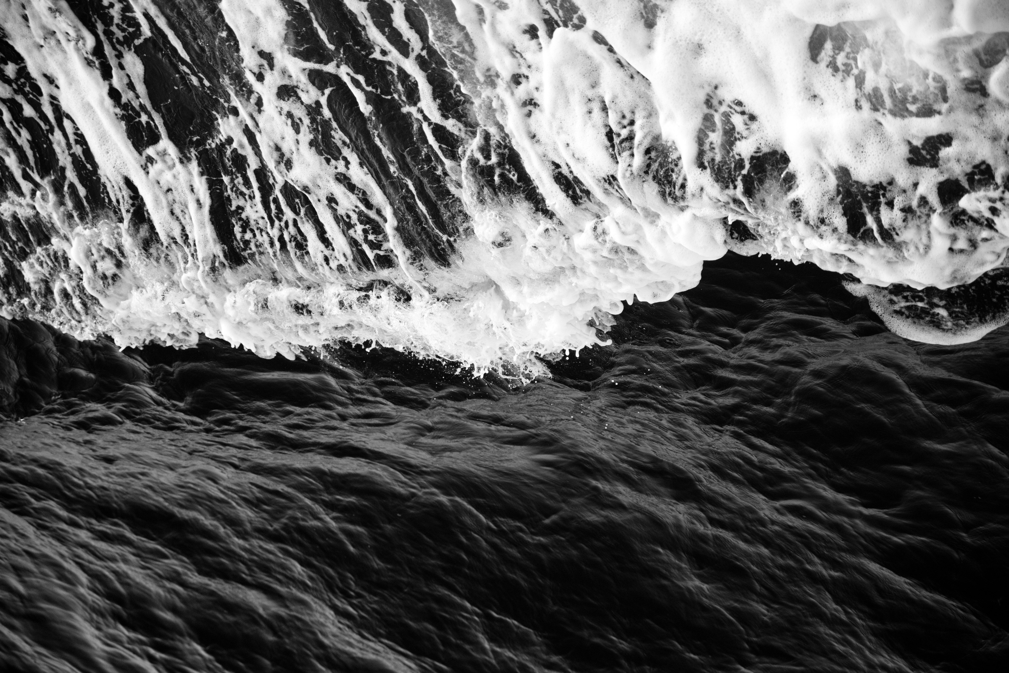
CASE 1 hydrodynamic performance

Slide 6
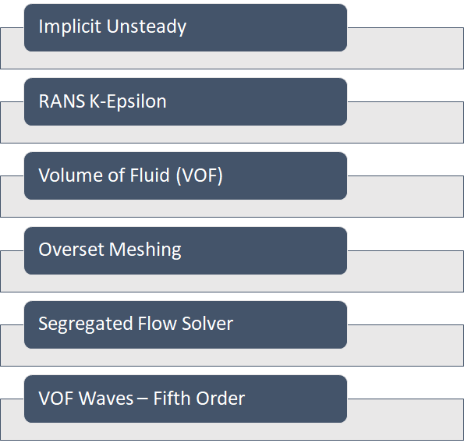
Key models
Purpose
Wave properties
The simulation was carried out to assess hull safety and comfort by verifying that wave slamming does not generate vertical accelerations above 1 g.
Oblique waves at 45 degrees onset to the boat
Wave height: 0.5m
Water depth: 100m
Wave period: 4s
boat
Velocity: 20 knots
Mass: 2500 Kg
Dimensions: 5.6m x 1.8m x 0.6m

Slide 7
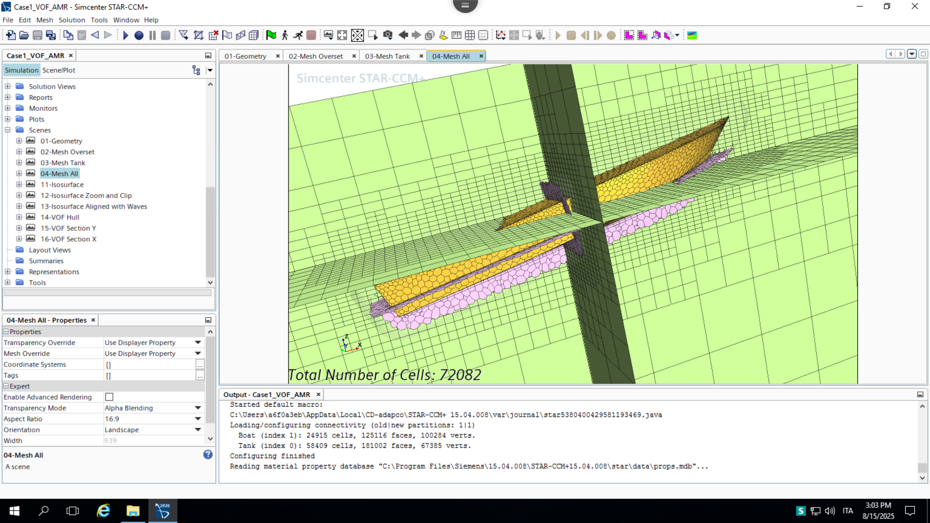
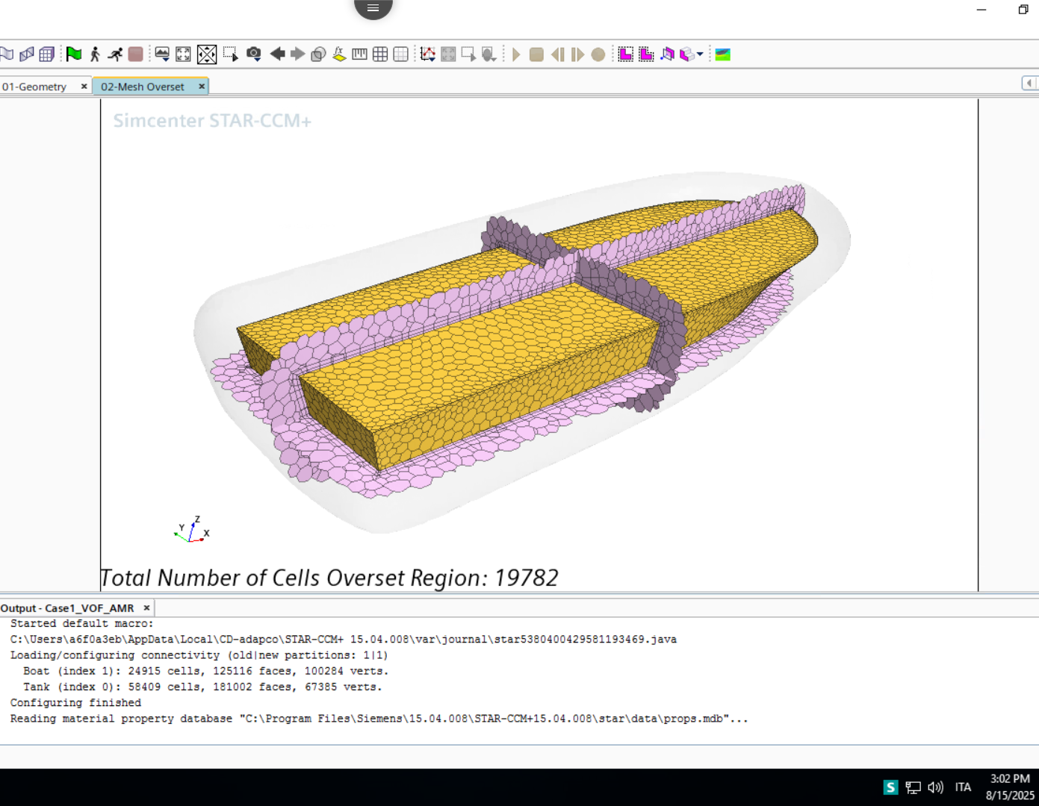
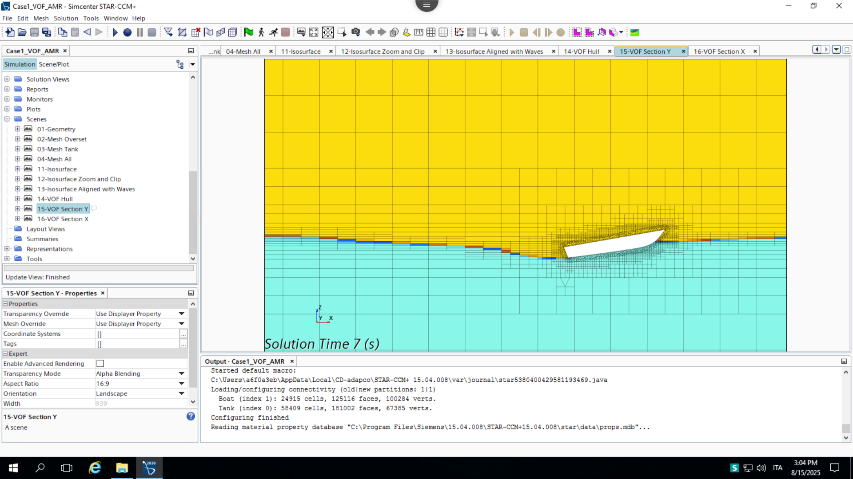
procedureS
The hull geometry was imported and positioned in oblique waves at 45°.
An overset mesh with Adaptive Mesh Refinement (AMR) was applied to capture the free surface motion
6DOF model enabled realistic hull motion (roll, pitch, heave).

Slide 8
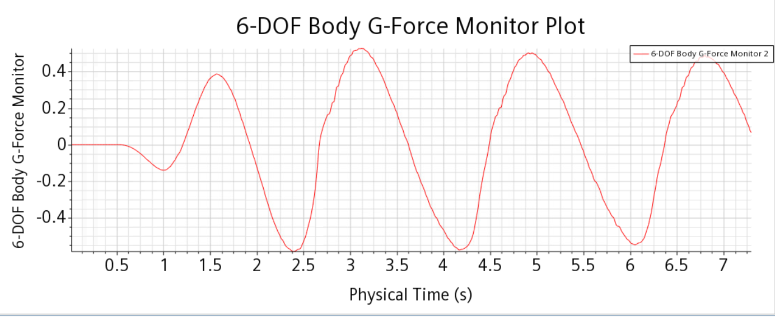
RESULTS
The boat experienced moderate roll (±3.8°), pitch (–12.5° to +0.2°), and a maximum heave of 0.5 m
The peak vertical acceleration was 0.58 g, remaining safely below the 1 g limit

Slide 9
CASE 2 external aerodynamics

Slide 10
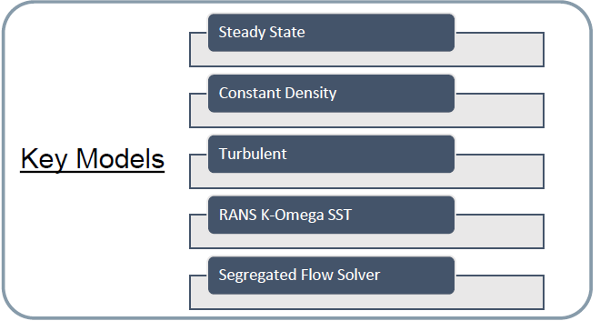
Key models
Purpose
Wind
conditions
The simulation aimed to ensure that the velocity in the vertical direction on the rear deck of the vessel did not exceed +/- 1.80 m/s
Wind speed: 10mph
Wind angle: 15 deg
boat
Dimensions: 200m x 35m x 55m

Slide 11
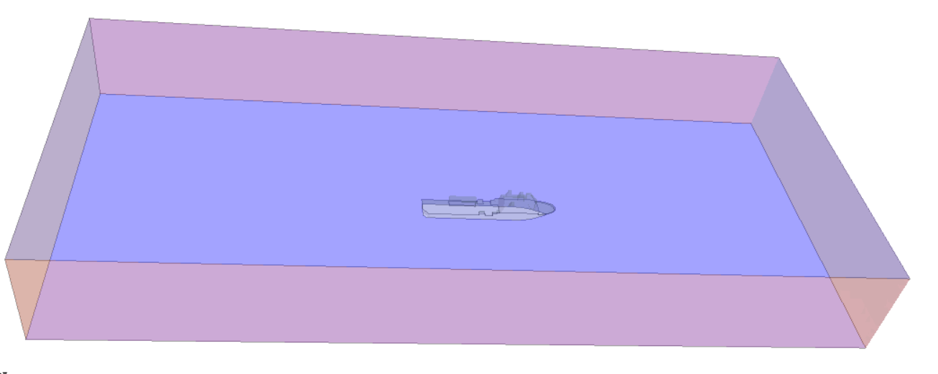
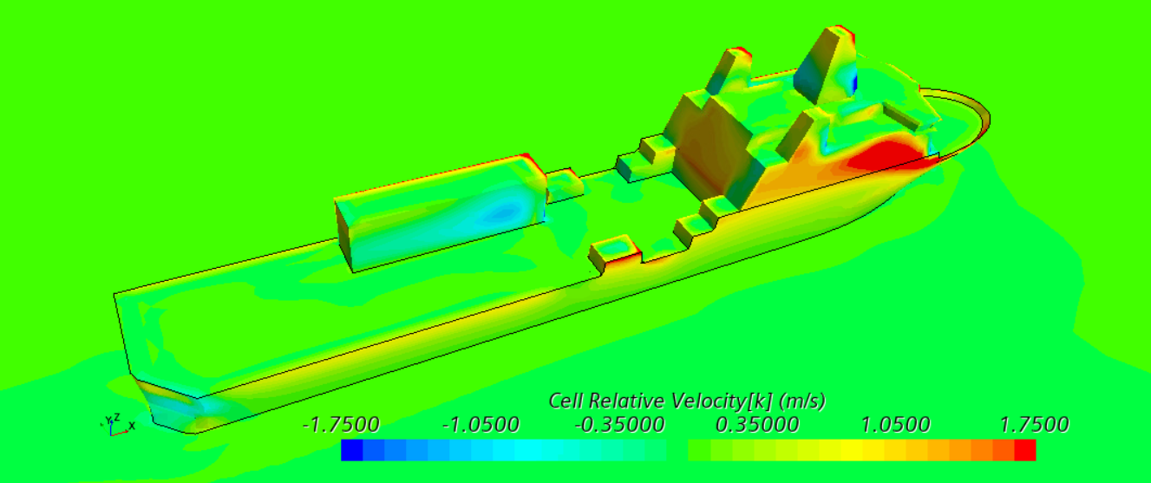
procedures
External flow domain created with refined boundary layer mesh
Steady-state CFD model applied to capture pressure and velocity distribution
Post-processing focused on drag coefficient and flow visualization

Slide 12
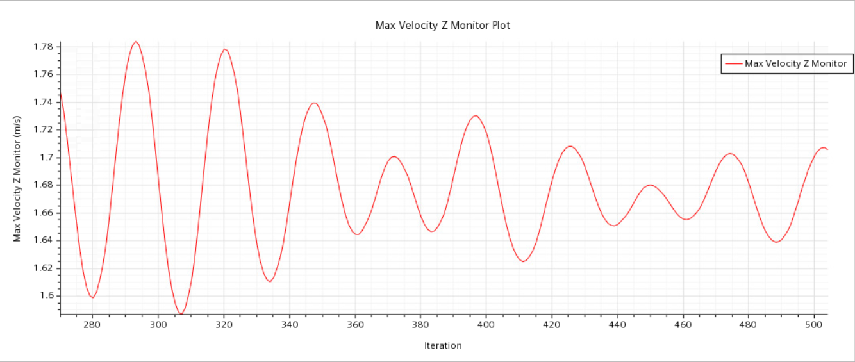
RESULTS
Minimal fluctuation therefore the simulation is stable and converged
The maximum vertical velocity has converged to 1.78m/s
The entire rear deck of the MRV is within the safety margin of 1.80m/s in the vertical

Slide 13
CASE 3 hydrofoil design exploration

Slide 14
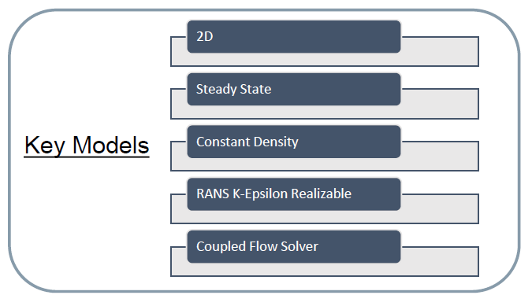
Key models
Purpose
Design and boundary
The simulation assessed hydrofoil performance to balance lift and drag for efficient hydrodynamic design. Objective:
Lift Coefficient >= 0.3
Minimize Drag Coefficient
Constant angle of attack: 0 deg
Modifying 2 points on the hydrofoil profile
Water velocity: 10 m/s
Angle of attack: 0 deg
Hydrofoil shape
Thickness: 0.19 m
Chord length: 1 m

Slide 15
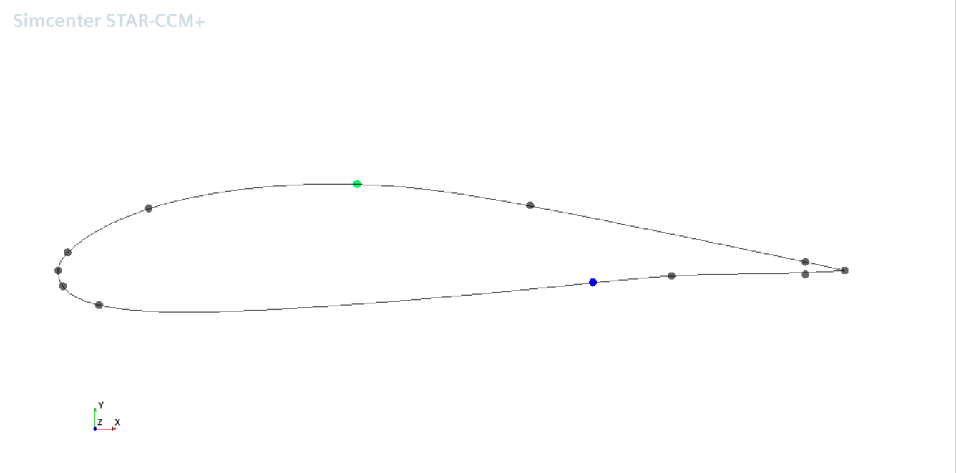
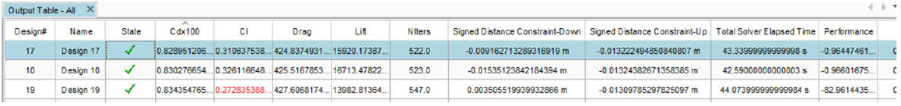
procedures
Hydrofoil geometry modeled under realistic flow conditions
Section planes and pressure contour visualizations created
Parametric study performed to explore performance variations

Slide 16
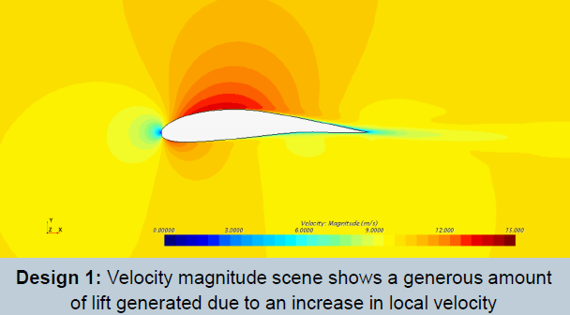
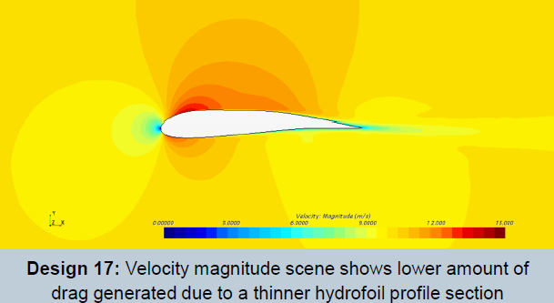
RESULTS
If we take a look at our starting hydrofoil, Design 1:
Cdx100 = 0.8595
Cl = 0.3869
In comparison our best hydrofoil design, Design 17:
Cdx100 = 0.8290
Cl = 0.3111
This optimization has reduced drag 3.6% while keeping a minimum Cl of 0.3 in just 25 iterations.

Slide 17
CASE 4 self propulsion

Slide 18
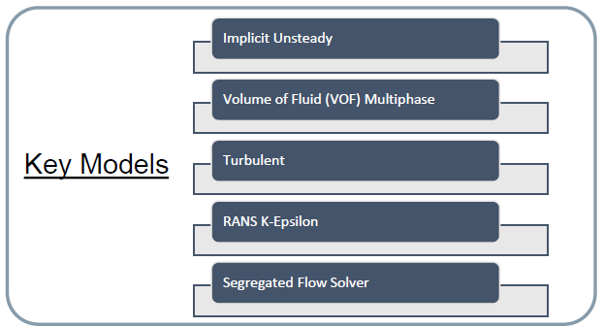
Key models
Purpose
conditions
The simulation investigated coupled hull–propeller interaction to analyze propulsion efficiency
Air Temperature: 26.5C
Type of water: Sea
Sea density: 1023 kg/m 3
Ship speeds: 9.3, 11.6, 13 knots
ship
Dimensions: 150m x 31m x 23m

Slide 19
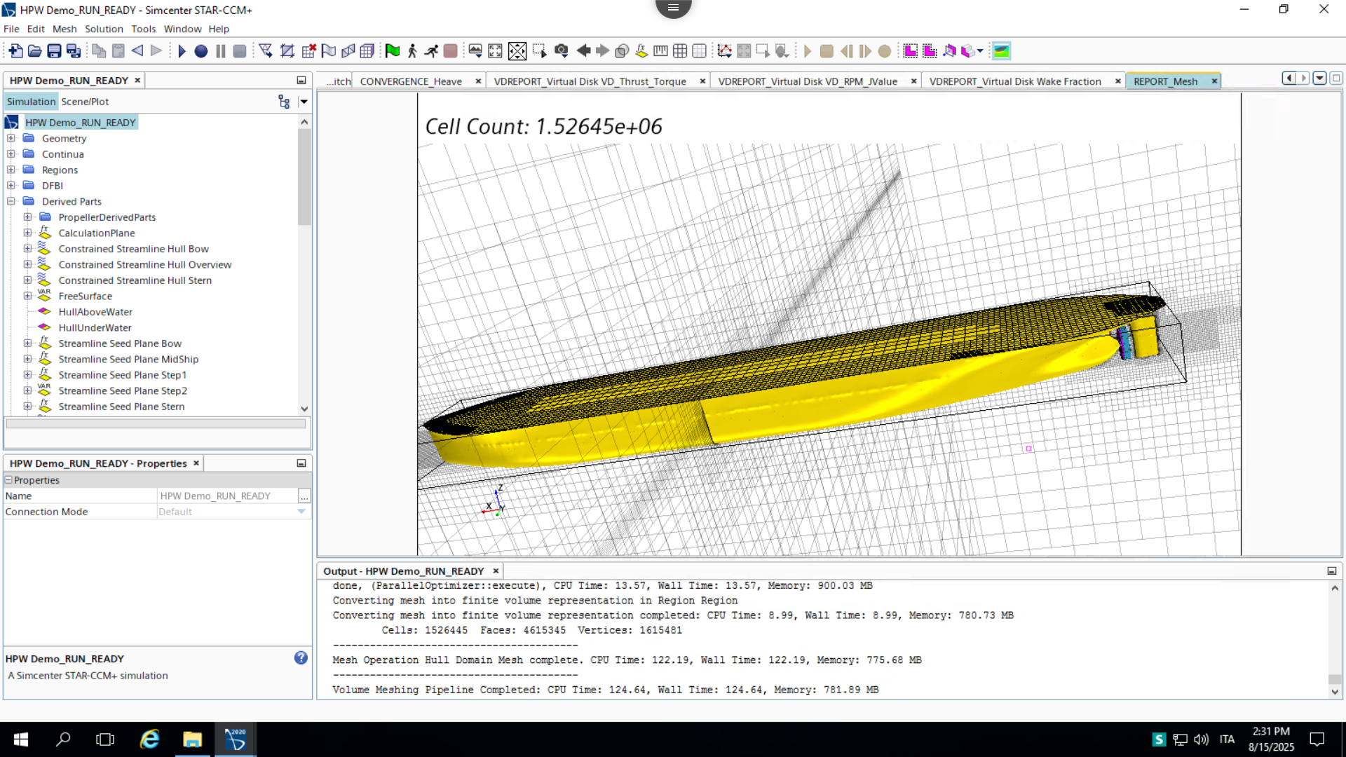
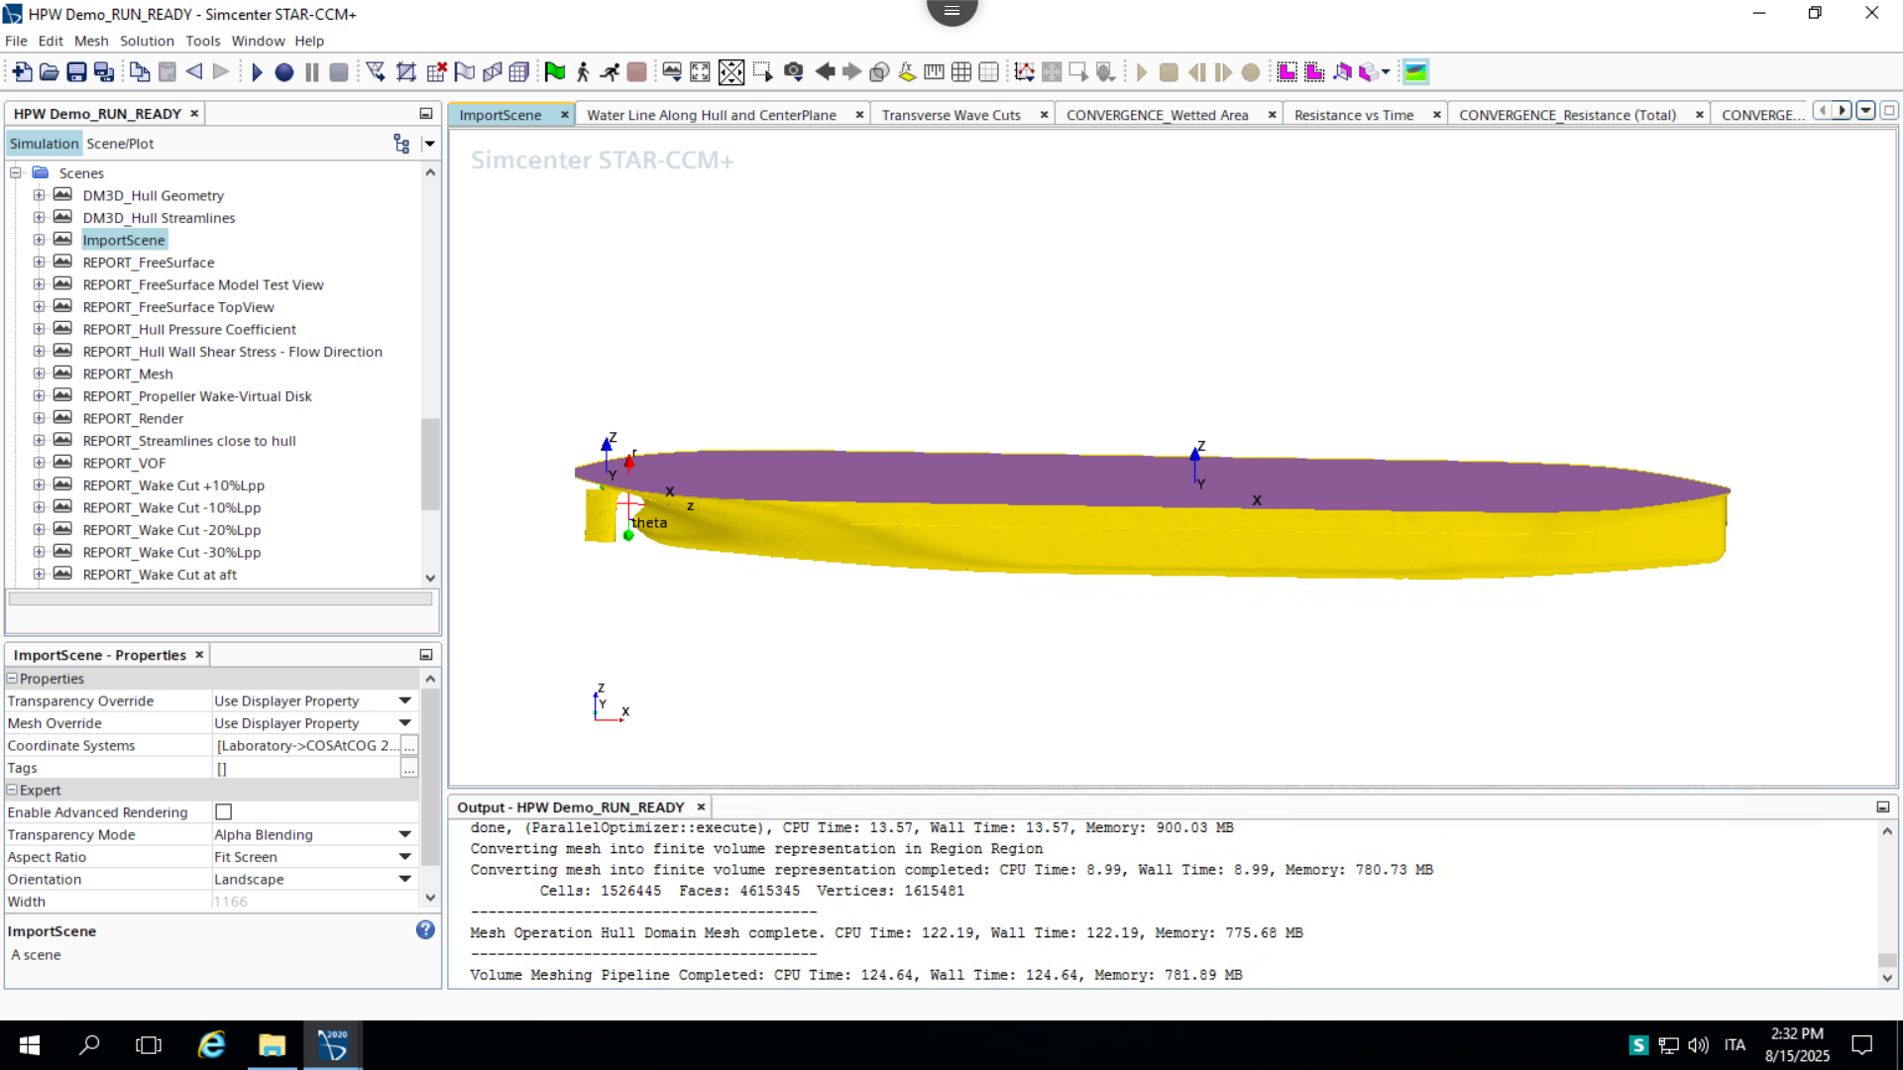
procedures
Propeller modeled using an overset mesh to capture rotating motion
Coupled CFD simulation performed with hull and propulsion system

Slide 20
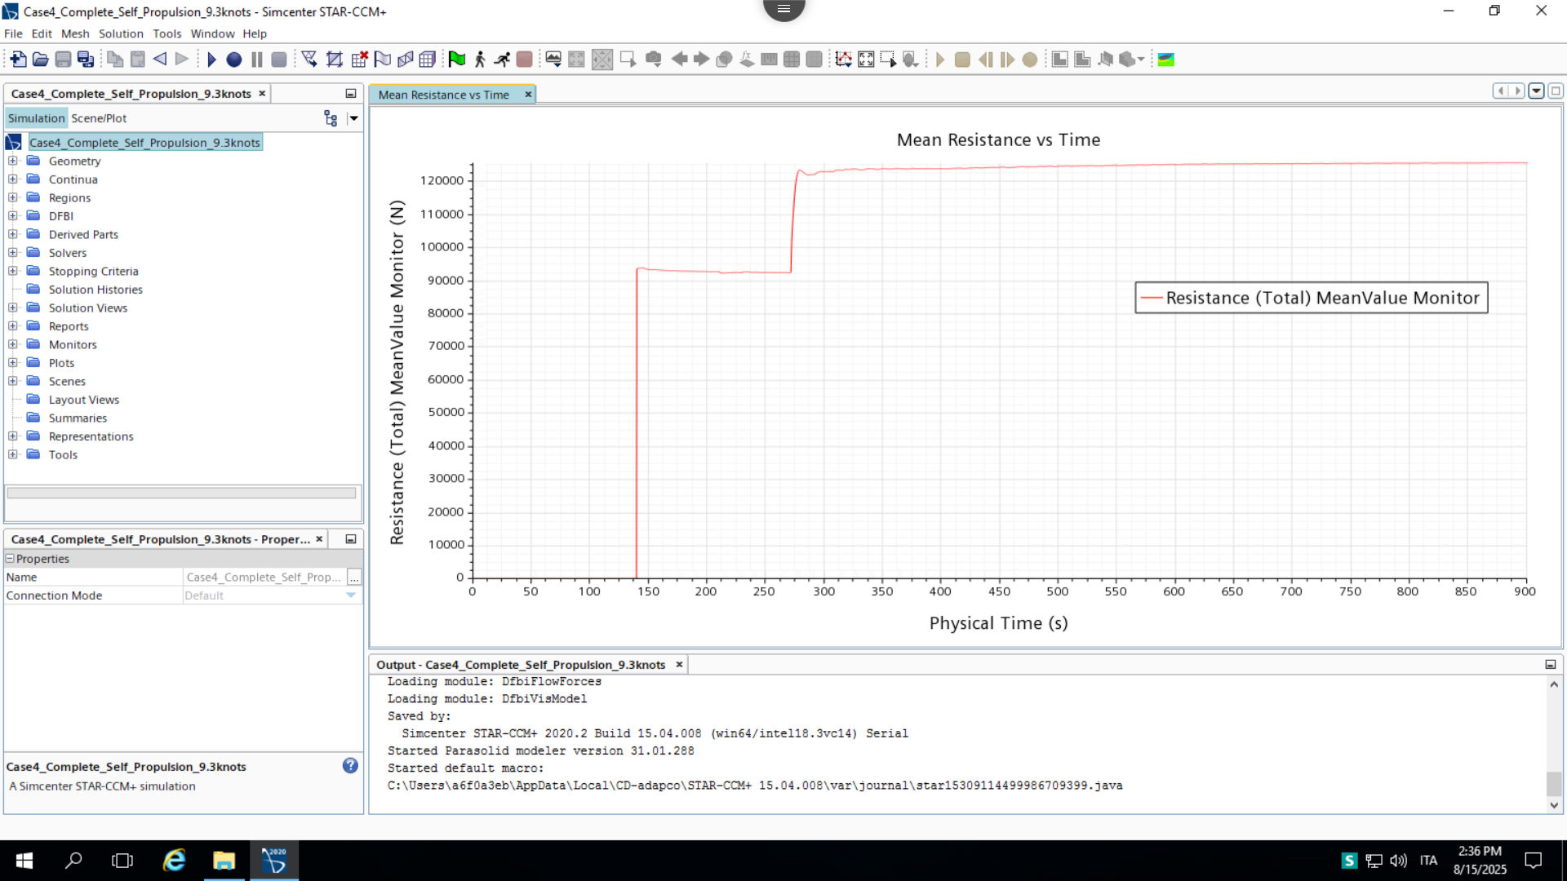
RESULTS
Thrust curves demonstrated propeller effectiveness across operating points
CFD analysis confirmed reliable performance for integrated hull–propeller system.

Slide 21
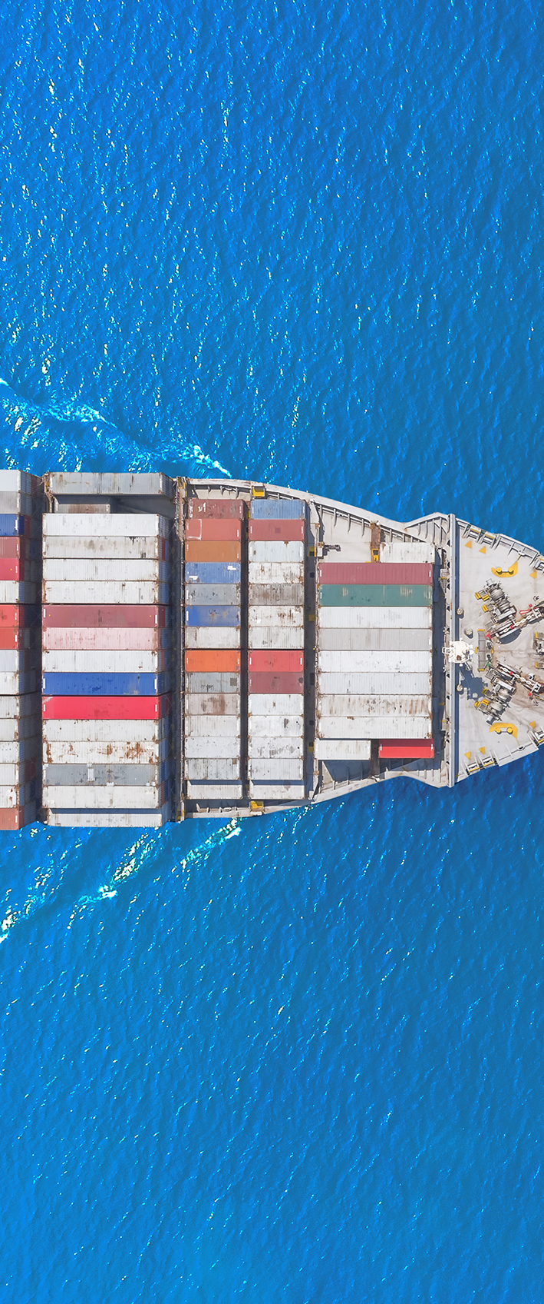
conclusions
Completed four marine CFD simulations using Siemens STAR-CCM+.
Each case explored a different aspect of marine design: hydrodynamics, aerodynamics, hydrofoil performance, and self-propulsion
Gained hands-on experience in:
Generating overset and adaptive meshes
Applying 6DOF models and monitoring hull motion
Post-processing results and extracting performance insights
Developed a solid understanding of CFD workflows and marine engineering analysis, enhancing technical and visualization skills for future projects.

Slide 22
THANK YOU
Enrico di Capua - enricodicapua6@gmail.com
www.linkedin.com/in/enrico-di-capua
https://bit.ly/portfolio-enrico-di-capua

